Slide 1
Organization Cybersecurity Policy and Executive Summary
Ryan Coon
CYB-650
Dr. Howard Goodman
August 27, 2025

Slide 2
CONTENTS
NIST Cybersecurity Framework
Cybersecurity Lifecycle and Methodologies
Organizational Security Policy
Organizational Systems and Network Diagram
Risk Assessment, Business Impact Analysis, and Business Continuity Plan
Comparison of Different Standards
Incident Response and Handling Plan
Cybersecurity Awareness Infographic
Executive Summary

Slide 3
NIST Cybersecurity Framework
NIST SP800-66 Revision 1: An introductory Resource Guide for Implementing the HIPAA Security Rule
Framework provides outline for compliance with HIPAA Security Rule
HIPAA Security Rule requires confidentiality, integrity, and availability of Electronic Personal Health Information
Standards are created to be compliant with HIPAA Security Rule
Notes:
Our cybersecurity framework will be meticulously crafted, drawing guidance from the NIST Cybersecurity Framework, specifically Special Publication 800-66 Revision 1, an invaluable "Introduction to Resources for Implementing the HIPAA Security Rule." This esteemed framework offers a detailed and robust roadmap, serving as our primary blueprint for achieving full compliance with the HIPAA Security Rule, the paramount standard our cybersecurity architecture must uphold.
As a vital medical entity, the HIPAA Security Rule imposes a non-negotiable mandate: the unwavering protection of the CIA Triad – Confidentiality, Integrity, and Availability – for all electronic Protected Health Information (ePHI). This encompasses the entirety of sensitive data, including all medical information, patient records, diagnostic imaging, and intricate treatment plans.
The standards we are establishing are purposefully designed for rigorous HIPAA Security Rule compliance. Consequently, a critical step involves a thorough assessment of our current security posture. This assessment will be conducted by comparing our existing defenses against these mandated standards, with the express purpose of elevating our security to meet and exceed these essential requirements.

Slide 4
NIST Cybersecurity Framework
Administrative Safeguards (4.1 - 4.9)
Security Management Process
Information Access Management
Security Incident Procedures
Physical Safeguards (4.10 - 4.13)
Facility Access Controls
Workstation Use and Security
Device and Media Controls
Technical Safeguards (4.14 – 4.18)
Access Controls
Audit Controls
Transmission Security
Notes:
The chosen NIST framework provides guidance on implementing three crucial categories of safeguards:
Administrative Safeguards: These cover policies and procedures for managing security.
Physical Safeguards: These focus on protecting the physical environment and access to it.
Technical Safeguards: These involve the technological measures used to secure information.
Each category is further divided into subcategories, as detailed in the framework document. Crucially, each subcategory is directly aligned with a specific requirement of the HIPAA Security Rule. Therefore, implementing these safeguards is a direct step towards achieving compliance.
For example:
Administrative Safeguards include security management processes, information access management, and security incident procedures.
Physical Safeguards encompass facility access controls, workstation use and security policies, and device and media controls.
Technical Safeguards involve access controls, audit controls, and transmission security measures.

Slide 5
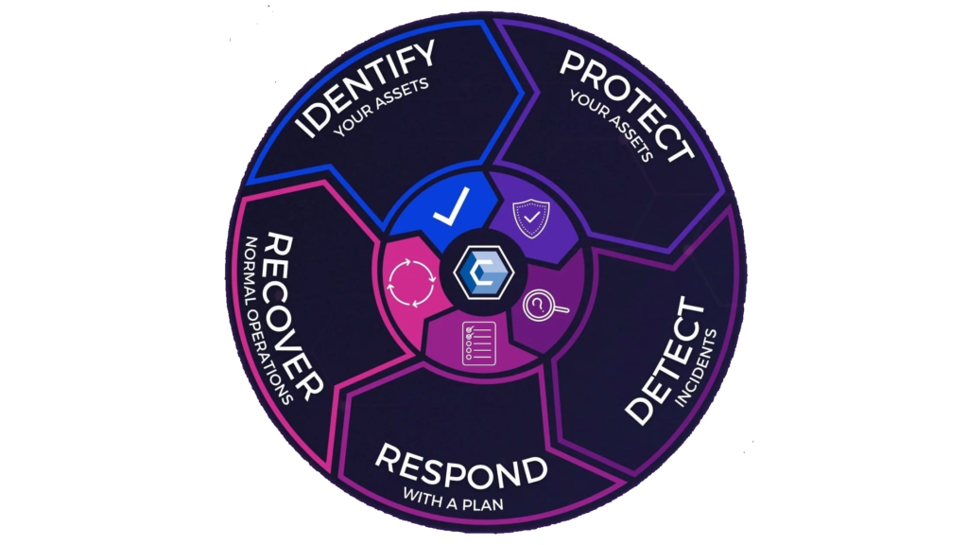
Cybersecurity Lifecycle and Methodologies
Identify – The organizational missions and priorities, assets, and goals
Protect – Implement the NIST Framework, firewalls, multifactor authentication, and employee training
Detect – Monitor network, use IPS and IDS
Respond – Quickly work to analyze attacks, contain attack, eradicate attacking malware
Recover – Restore systems functionality, patch vulnerabilities
Notes:
The methodology used to construct our cybersecurity program is centered on a deep understanding of our organizational mission, priorities, assets, and strategic goals. This initial step of Identifying is paramount, as it directly influences how the framework will be implemented to effectively protect our data. While compliance with industry standards is essential, a comprehensive cybersecurity framework must be strategically aligned with the organization's overall objectives.
The program then progresses through the cybersecurity lifecycle:
Protect: This involves the practical implementation of the NIST framework, alongside the deployment of firewalls, multi-factor authentication, comprehensive employee training programs, and other crucial measures designed to fortify our network against potential attacks.
Detect: This stage entails continuous network monitoring, the utilization of intrusion prevention systems (IPS) and intrusion detection systems (IDS), to proactively identify and flag any potential security breaches or malicious activities.
Respond: This phase is focused on a rapid and effective response to any detected attacks, involving a thorough analysis of the threat, the immediate containment of the incident, and the swift eradication of any malicious software.
Recover: The final stage of the lifecycle focuses on the complete restoration of our systems to full operational functionality, coupled with the critical task of patching any identified vulnerabilities to prevent future exploits.

Slide 6
Organizational Security Policy
Reflects the organizational goals and priorities
Compliance with standards (HIPAA)
Identifies and protects against attack vectors, including insider threats
Implements comprehensive policies
Acceptable Use Policy
Onboarding and Offboarding Policies
Social Media Policy
Mobile Device Policy
Notes:
The organizational security policy is meticulously crafted to align with the organization's overarching goals and priorities. Crucially, it also ensures full compliance with HIPAA standards.
This policy proactively identifies and safeguards against a diverse array of attack vectors, with a particular emphasis on mitigating insider threats. This comprehensive protection is achieved through the implementation of robust policies that address a wide spectrum of potential attacks.
Key policies forming the bedrock of our security posture include:
Acceptable Use Policy: Defining the appropriate use of organizational resources.
Onboarding and Off-boarding Policies: Ensuring secure transitions for employees.
Social Media Policy: Guiding responsible engagement on social platforms.
Mobile Device Policy: Establishing security protocols for mobile devices.

Slide 7
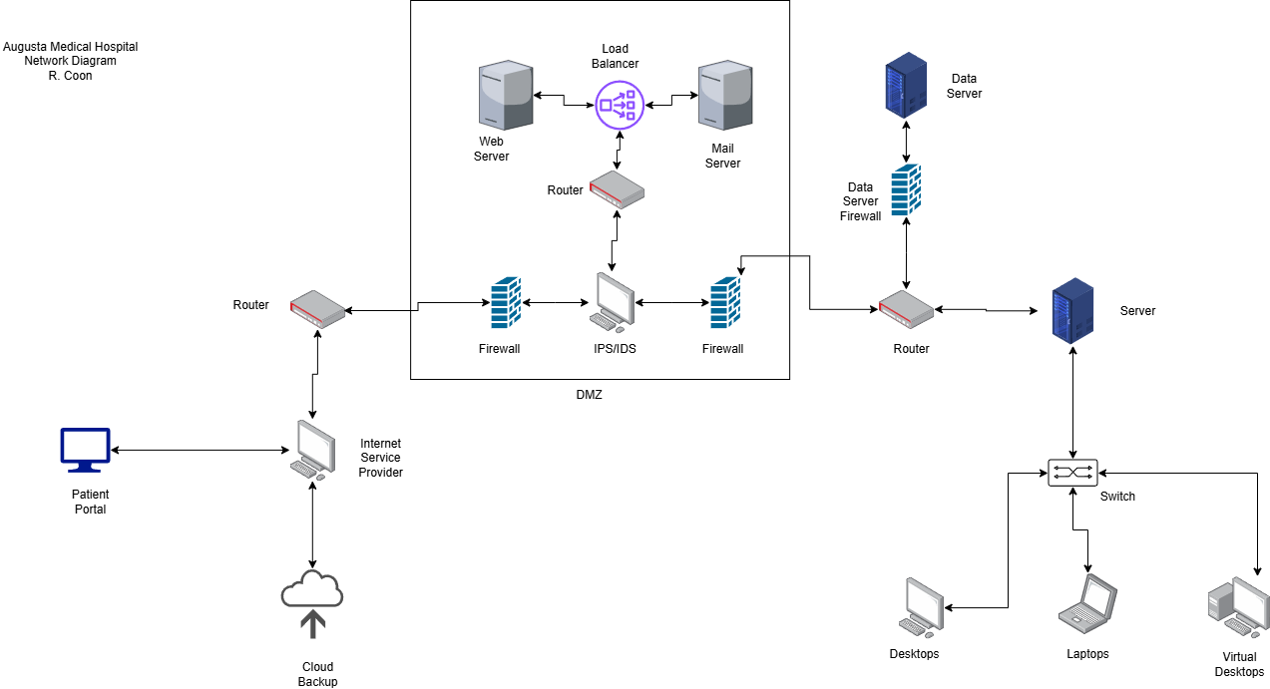
Organizational Systems and network diagram
Notes:
The network diagram illustrates our organizational systems, beginning with the outward-facing components: the general website and the secure patient portal. These are routed by our Internet Service Provider (ISP) into the Demilitarized Zone (DMZ).
Within the DMZ, all network traffic is meticulously inspected by a series of defensive structures, including a firewall, an Intrusion Detection System (IDS), and an Intrusion Prevention System (IPS). Both our mail and web servers are strategically located within the DMZ, positioned behind these initial layers of defense.
Upon transitioning from the DMZ into our internal network, traffic must first traverse an additional firewall. Following this, it is routed either to the main server or the secure data server. Accessing the secure data server requires passing through yet another firewall, and it's important to note that all data stored on this server is encrypted, both when at rest and in motion.
Employees and other authorized users will access the main server using various devices, such as desktops, laptops, and virtual desktops. While these users can request data from the secure data server, our implementation of the principle of least access, along with other robust access control techniques, will effectively prevent any unauthorized access to the secured data.

Slide 8
Risk Assessment, Business Impact Analysis, and Business Continuity Plan
Risk Assessment
Business Impact Analysis
Business Continuity Plan
Identifies vulnerabilities in the network and systems
Identifies threats, threat vectors, and possible targets
Can be conducted as a penetration test
Identifies the effect of a successful attack would have on the organization
Qualitative versus Quantitative Analysis
Consequences – Financial, Reputational, Sanctions and fines
Identifies how to recover or maintain business functions in the case of a disaster
Allows for customization and innovation to meet challenges faced
Goal is business continuity rather than full business recovery
Notes:
The next part of the organizational policy is the risk assessment business impact analysis and business continuity plan the risk assessment is an evaluation that is designed to identify vulnerabilities in the networking systems it identifies threats threat vectors attack vectors and possible Targets this can be conducted as a penetration test or just a regular assessment the business impact analysis identifies the effect that a successful attack would have on the organization there are both qualitative and quantitative analyzes that can be performed and some of the consequences of a successful attack are Financial loss, reputational loss, and fines and sanctions for failing to comply fully with the HIPAA requirements the business continuity plan is designed to identify how to recover or maintain business functions in a disaster the business continuity plan allows for a wide variety of customization and Innovation since the challenges that are met in a disaster are abnormal and are hard to plan for it should be noted that the goal for the business continuity plan is business continuity this does not mean it is a full business recovery it is the basics that are required to keep the business functioning during the disaster

Slide 9
Comparison of Different Standards
HIPAA Security Rule
Ensure the confidentiality, integrity, and availability of all Electronic Personal Health Information that they create, receive, maintain, or transmit
Identify and protect against reasonably anticipated threats to the security or integrity of the information
Protect against reasonably anticipated, impermissible uses or disclosures
Ensure compliance by their workforce
HITECH
Requires the adoption of electronic health records over the antiquated paper records
Notes:
As we've discussed, the HIPAA Security Rule is the primary standard we, as a medical facility, must adhere to. The HIPAA Security Rule is based on four key principles:
Confidentiality, Integrity, and Availability (CIA): We must ensure the confidentiality, integrity, and availability of all electronic Protected Health Information (ePHI) that is created, received, maintained, or transmitted.
Threat Protection: We must identify and protect against any reasonably anticipated threats to the security or integrity of this information.
Protection Against Impermissible Use: We must protect against reasonably anticipated impermissible uses or disclosures of the information.
Workforce Compliance: We must ensure compliance with these standards by our workforce.
In addition to the HIPAA Security Rule, we are also required to comply with the HITECH Act. This law mandates the adoption of electronic health records (EHRs) over paper-based records. This requirement is a significant factor driving the need to update our security policy.

Slide 10
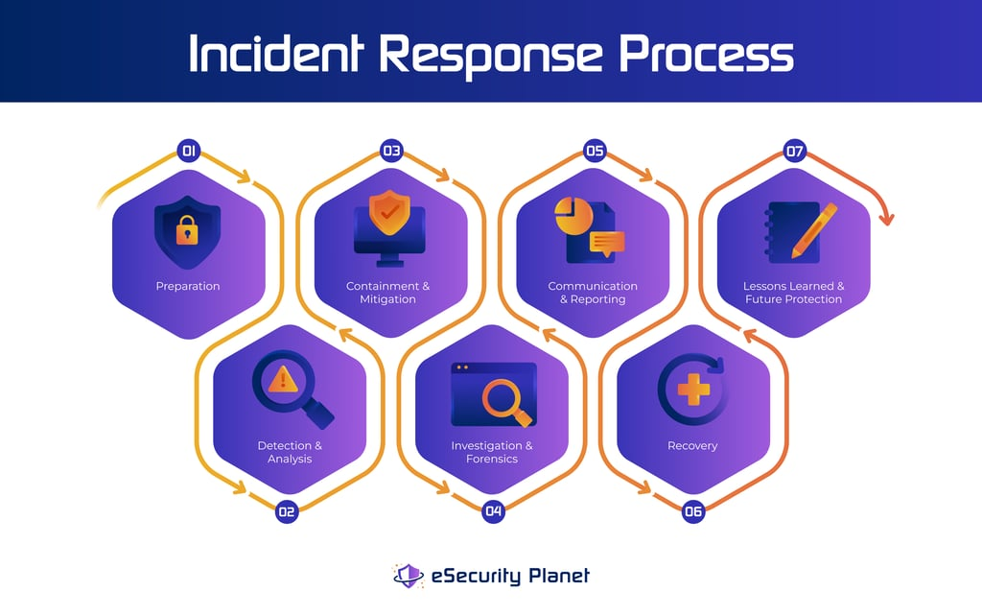
Incident response and handling plan
Incident Response Team
Leader, Coordinator, Responder, Communicator
Planning and responding to incidents, communication with stakeholders and external authorities
Steps of Incident Handling
Preparation (Early Detection)
Analysis
Containment and Mitigation
Investigation and Forensics
Communication and Reporting
Recovery
Lessons Learned and Future Protection
Notes:
Our policy also includes a detailed incident response and handling plan. This plan is executed by an incident response team, which is composed of several key roles:
Leader: Responsible for understanding and representing the organization's interests.
Coordinator: Manages the team of responders and overall incident response efforts.
Responders: The individuals directly involved in addressing and resolving the incident.
Communicator: Responsible for communicating with law enforcement, management, and other relevant stakeholders.
The incident response team's primary responsibilities include planning for and responding to incidents, as well as communicating with stakeholders and external authorities.
The incident handling plan follows a seven-step process:
Preparation: Utilizing cybersecurity tools and human intelligence to proactively detect attacks in their early stages.
Analysis: Performing an initial analysis of the event to determine if an actual attack is underway or if it's a false positive.
Containment and Mitigation: Prioritizing which attacks require immediate attention and identifying vulnerable data centers or data.
Notification: Initiating the initial notification of an active attack, summoning the incident response team, and commencing the containment and forensics process.
Containment and Forensics: The incident response team works to contain the attack and collect forensic evidence that may be used for prosecution.
Recovery: Utilizing backup drives and information to restore the system to full functionality after the attack has been contained.
Post-Incident Activity (Review): Conducting a thorough review of the incident response process to identify what worked well and what could be improved for future incidents. This also includes analyzing the incident itself to identify areas where we can adjust our security framework to enhance our defenses

Slide 11
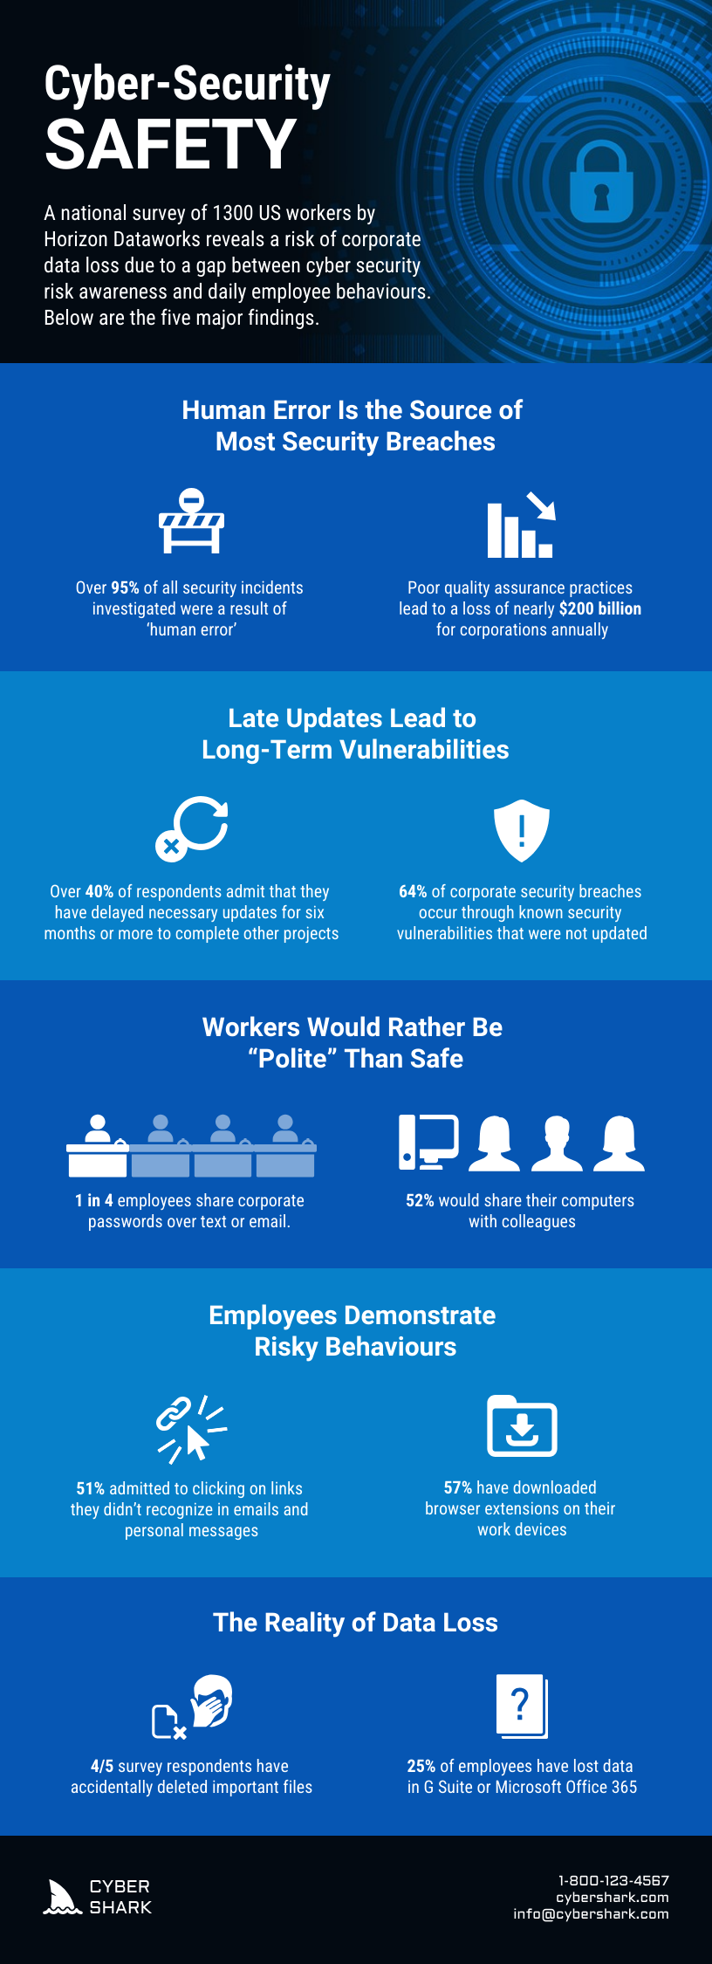
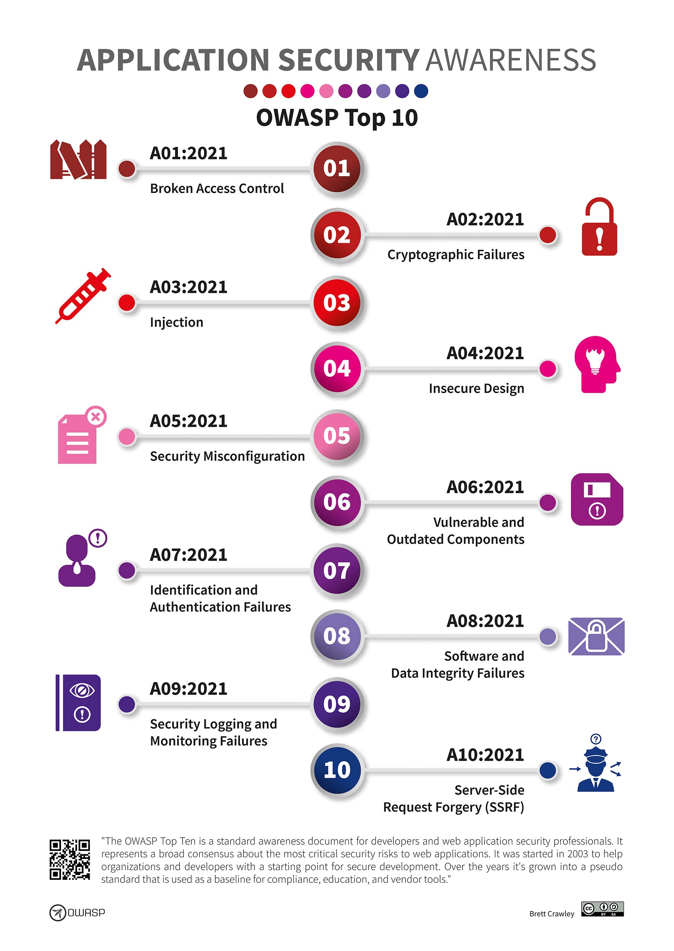
Cybersecurity Awareness Infographic

Slide 12
Executive Summary
Augusta Medical in Augusts, Ga.
Twenty-two Doctors and hundreds of staff serving over 10,000 patients
Mission
Our mission is to provide leadership and excellence in teaching, discovery, clinical care, and service as a student-centered comprehensive research university and academic health center, with a wide range of programs from learning assistance through postdoctoral studies.
Goals
Upgrading security and cybersecurity framework to comply with HIPAA
Upgrading systems and network to provide better care and information to patients
Notes:
Augusta Medical Hospital, based in Augusta, Georgia, is a robust healthcare institution boasting 22 physicians and hundreds of dedicated staff members, serving approximately 10,000 patients. Our core mission is to provide exceptional leadership and excellence across teaching, discovery, clinical care, and service. As a student-centered, comprehensive research university and academic health center, we offer a broad spectrum of educational programs, from foundational learning assistance to advanced post-doctoral studies. Our primary objectives are to significantly upgrade our security and cybersecurity framework to meet stringent HIPAA requirements and to enhance our systems and network infrastructure, thereby ensuring superior patient care and more efficient information delivery.

